Slide 1
K-Means Clustering
By: Daniel Peterson

Slide 2
Introduction to Segmentation
Segmentation is the partitioning of an image into many meaningful segments according to some charcteristic
Points within a given region are similar to other points within the same region
Points outside of a given region are significantly different than the points within a given region
Different techniques to segment images:
  Thresholding
  Edge-Based
  Region-Based
Segmentation provides easier analysis of images

Slide 3
K-Means Clustering
K-means clustering is a technique in which segments an image into k different groups of points, called clusters
Points are grouped together based on the cluster center which they are closest to
  There is a distance for each point to each of the cluster centers
Cluster centers are re-evaluated whenever a new point is assigned to a cluster
Points can move to different clusters based on these new centers
Continues until stopping condition is met
Guarantees convergence

Slide 4

Determining Cluster Centroids
Formula to determine the location of the cluster centroid
Sums all of the distances and divides by the number of points in the cluster
This minimizes the sum of the distances between each point and the center

Slide 5


RSS Calculation Formula
The Residual Sum of Squares (RSS) is the total sum for each of the distances in a cluster
This value is meant to be minimized for the best clustering to occur

Slide 6
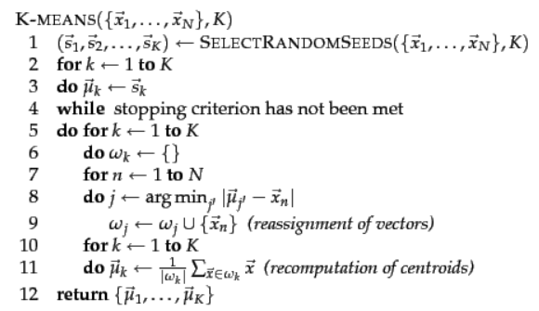
How to Minimize
Initial seeds are important
Number of cluster centers
K-means++
Optimal seeds
Faster and more accurate
Stopping criteria for fast runtime

Slide 7
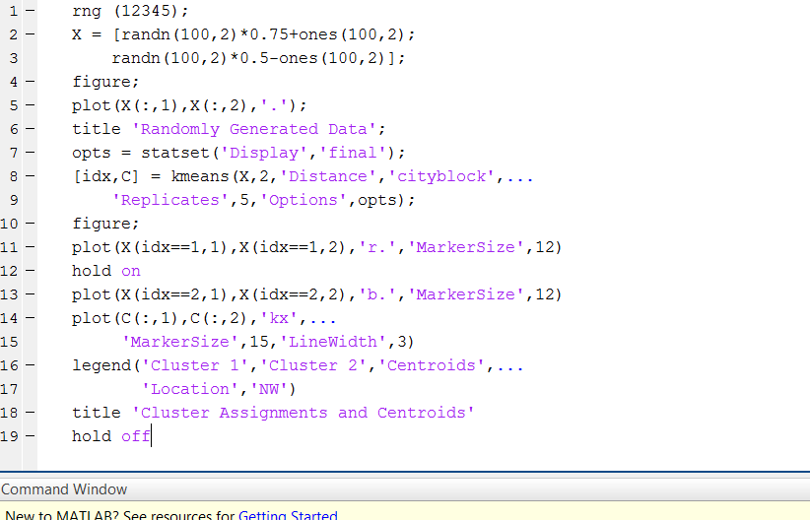
Clustering Example

Slide 8
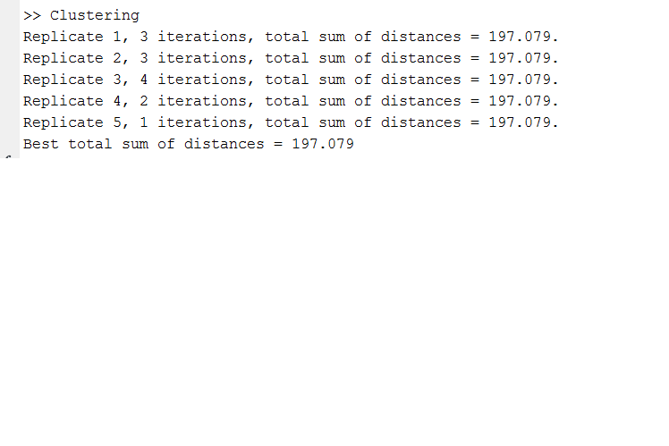
Clustering Example

Slide 9
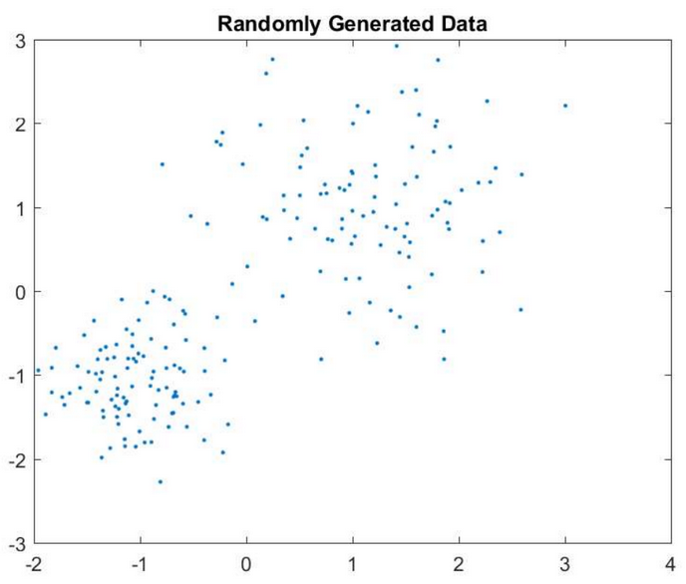
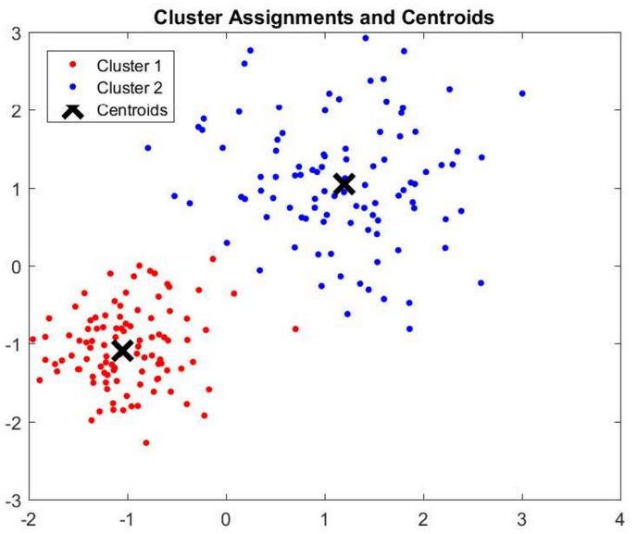
Before K-Means Clustering
After K-Means Clustering

Slide 10
Applications
PET scans for tissues
MRI for tumors
X-rays
More accurate care for patients

